Slide 1
Wireless Communications
Principles and Practice
2nd Edition
T.S. Rappaport
Chapter 3: The Cellular Concept – System Design Fundamentals

Slide 2
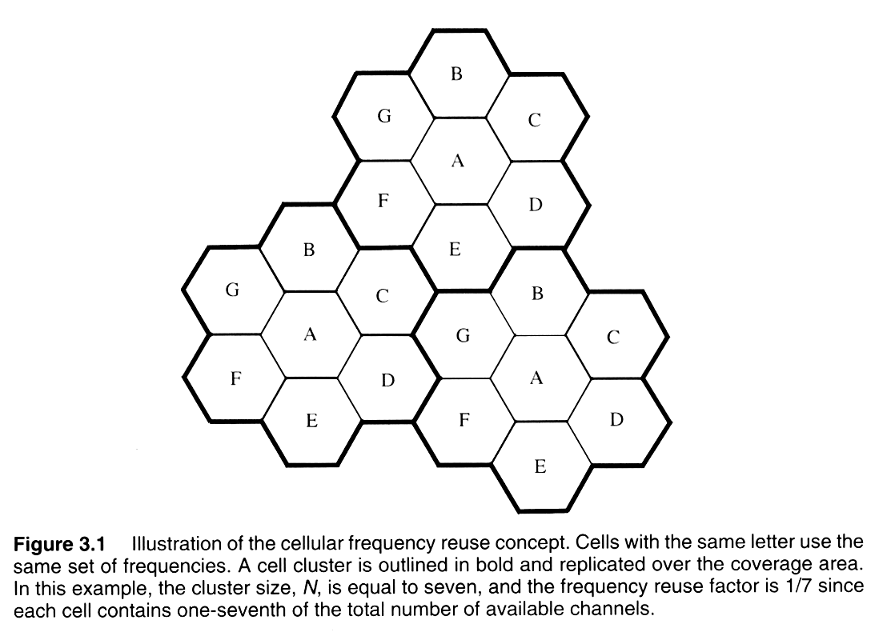
The Cellular Concept

Slide 3
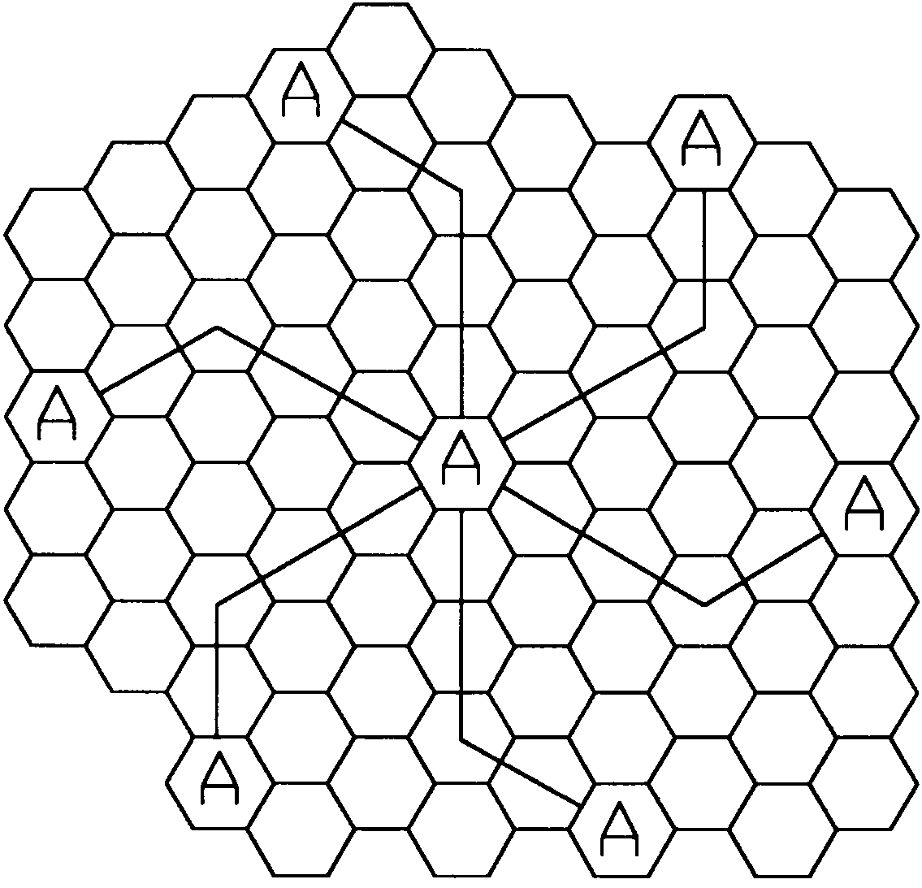
19-cell reuse example (N=19)
Figure 3.2 Method of locating co-channel cells in a cellular system. In this example, N = 19 (i.e., I = 3, j = 2). (Adapted from [Oet83] © IEEE.)
Notes:
Fig. 3.2

Slide 4
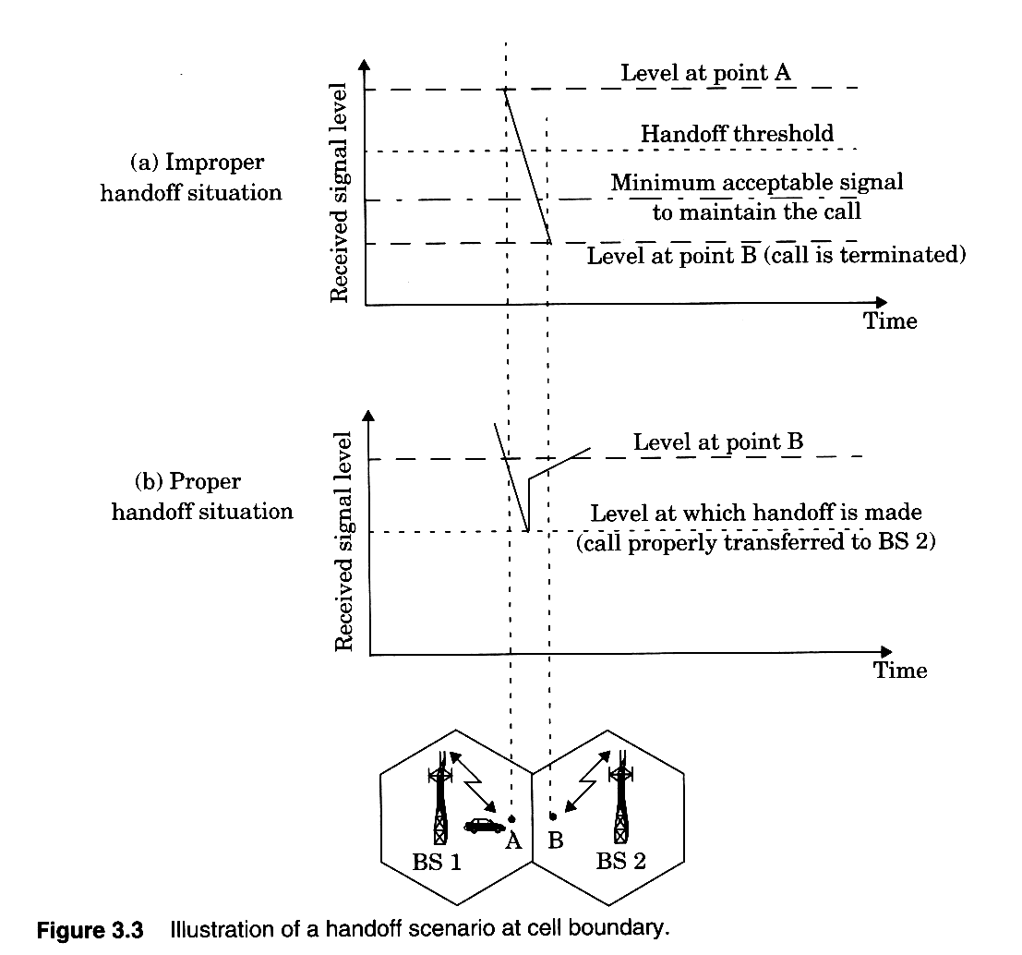
Handoffs – the basics

Slide 5
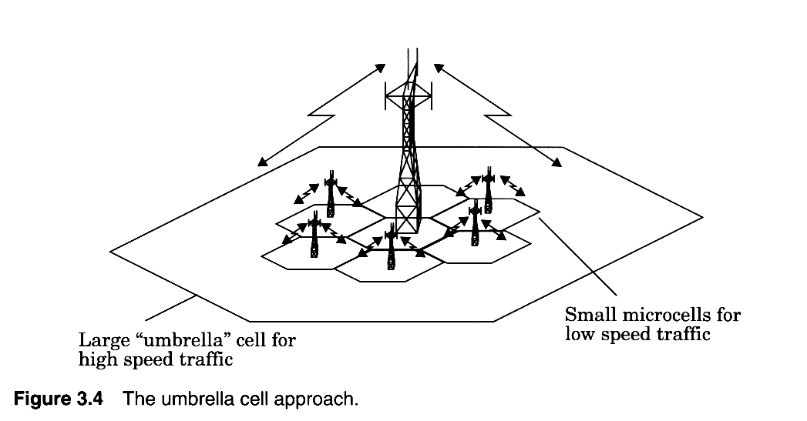
Umbrella Cells

Slide 6
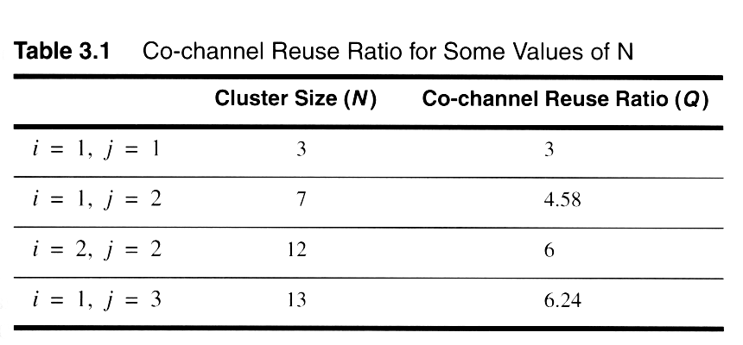
Smaller N is greater capacity

Slide 7
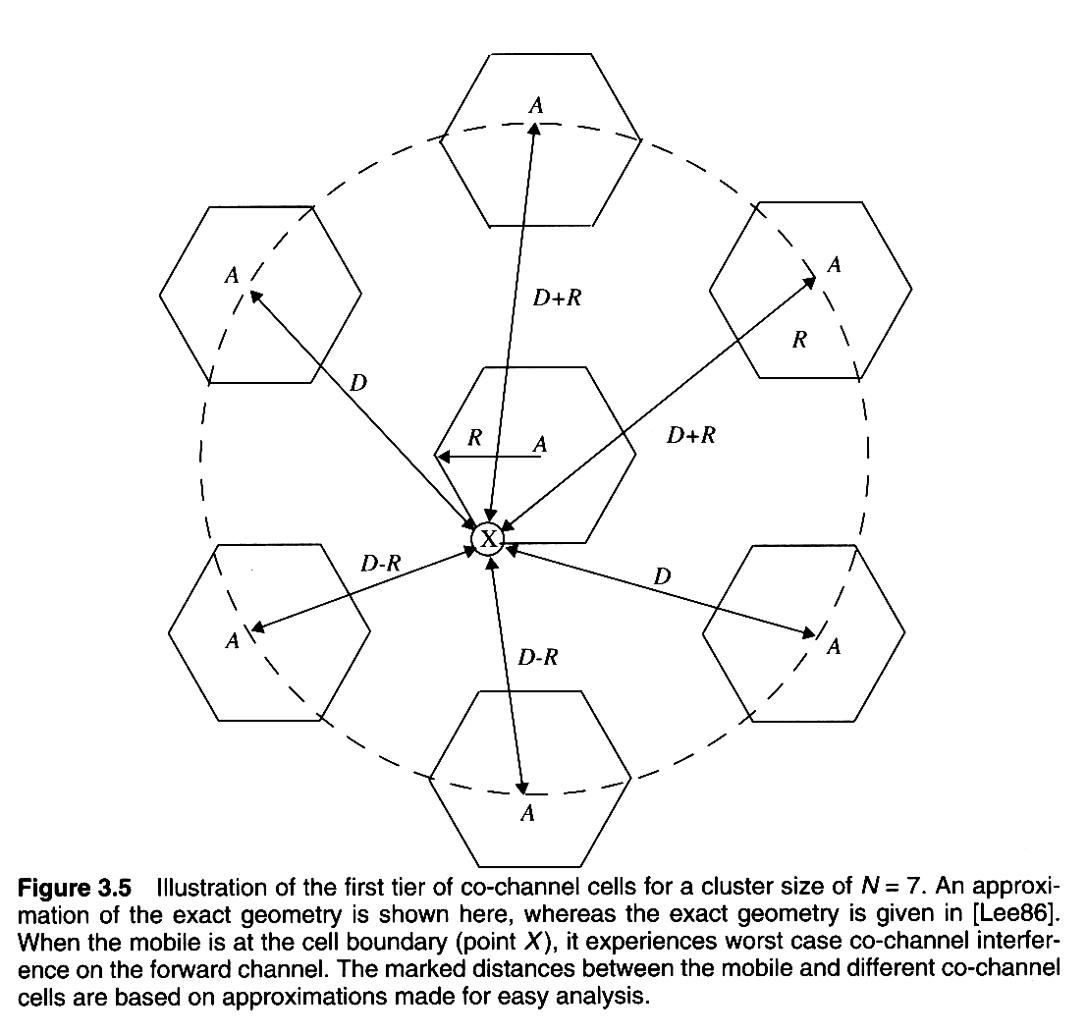
Co-channel cells for 7-cell reuse
Notes:
Fig. 2.4

Slide 8
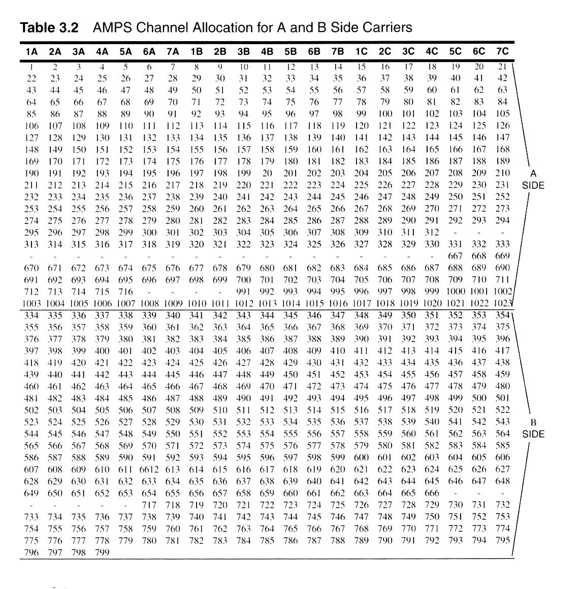
AMPS Duopoly Channels
Notes:
Fig. 2.5

Slide 9
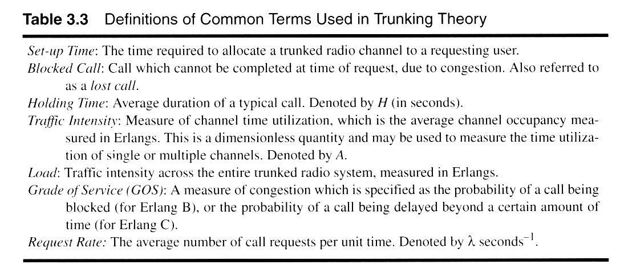
Key Definitions for Trunked Radio
Notes:
Fig. 2.6

Slide 10
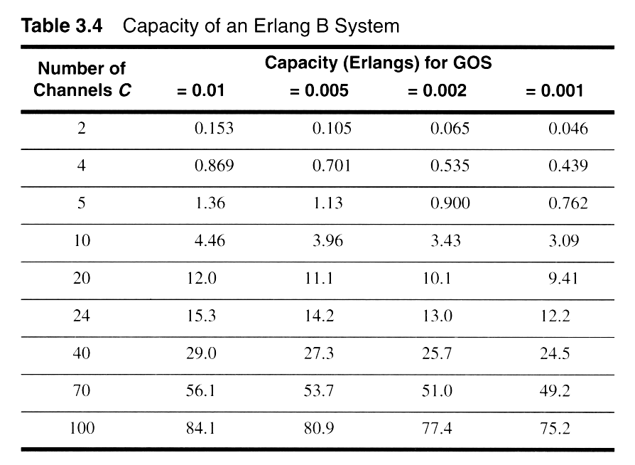
Erlang B Trunking GOS
Notes:
Fig. 2.7

Slide 11
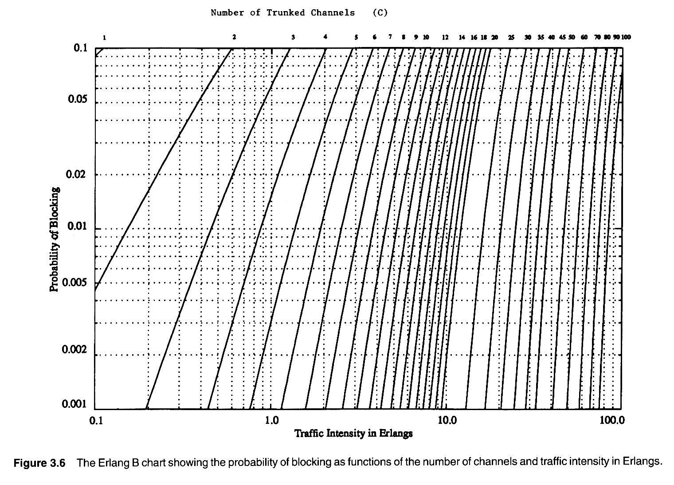
Erlang B
Notes:
Fig. 2.8

Slide 12
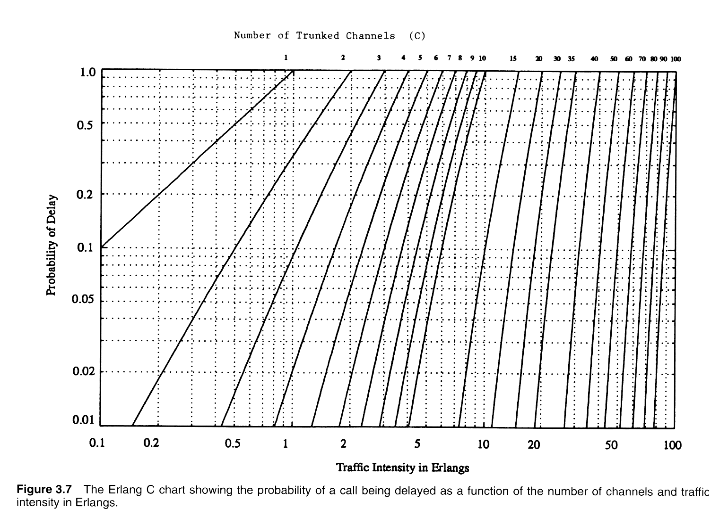
Erlang C
Notes:
Fig. 2.9

Slide 13
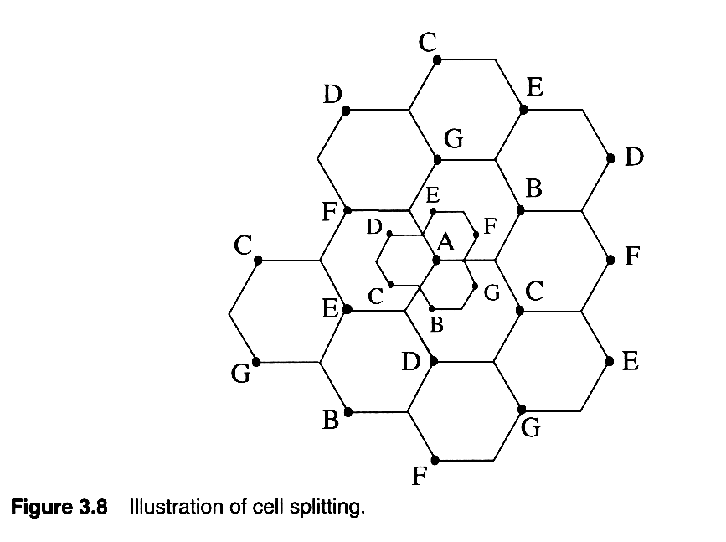
Cells are split to add channels with no new spectrum usage
Notes:
Fig. 2.10

Slide 14
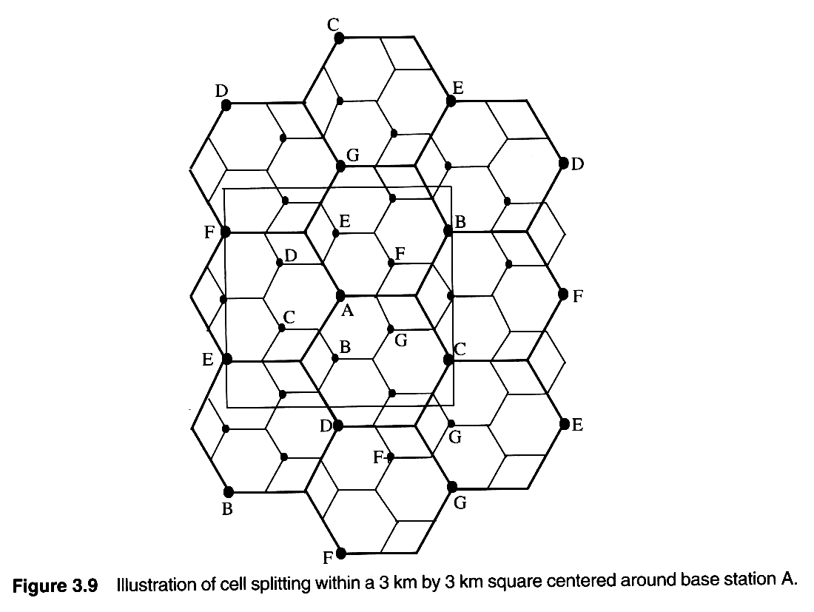
Cell Splitting increases capacity
Notes:
Fig. 2.11

Slide 15
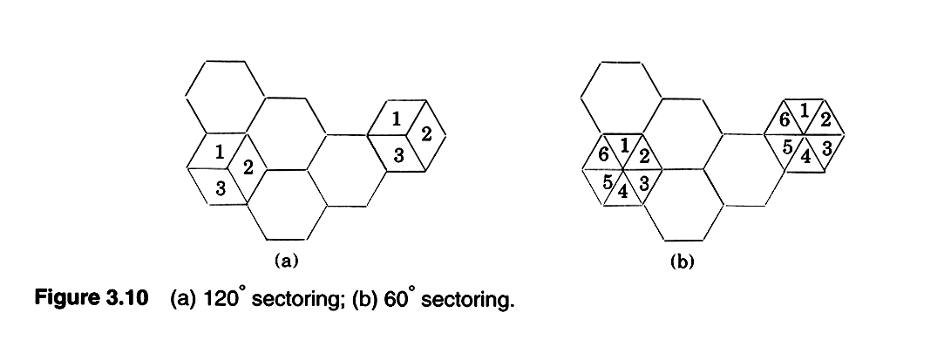
Sectoring improves S/I
Notes:
Fig. 2.12

Slide 16
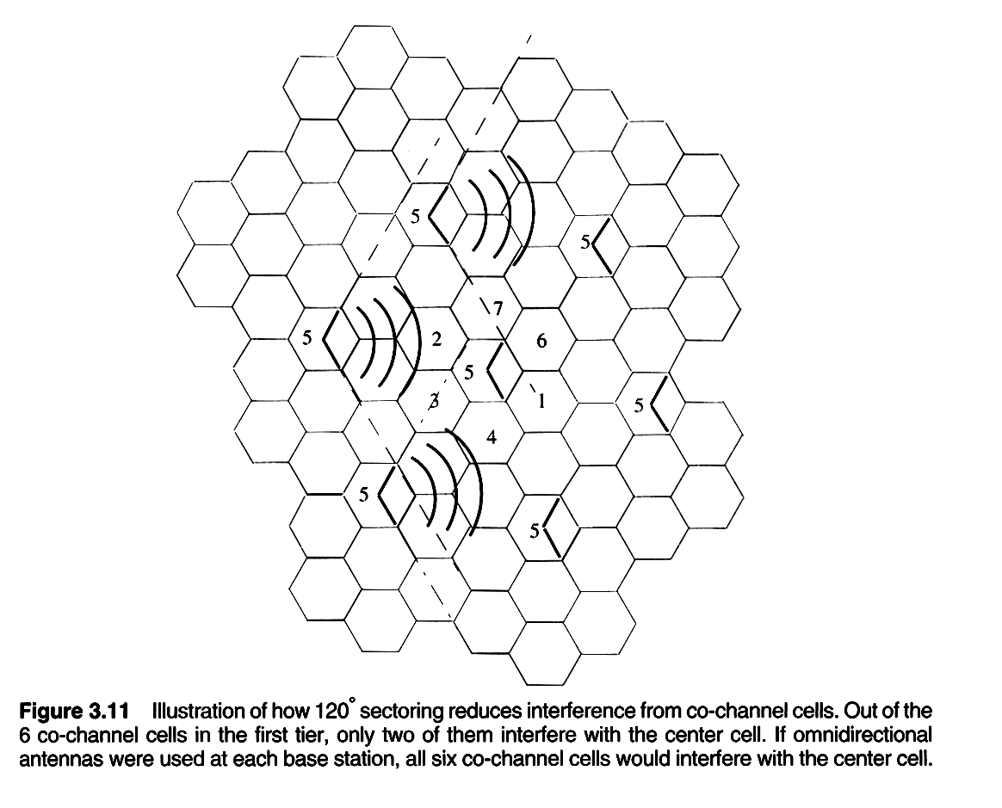
Sectoring improves S/I
Notes:
Fig. 2.13

Slide 17
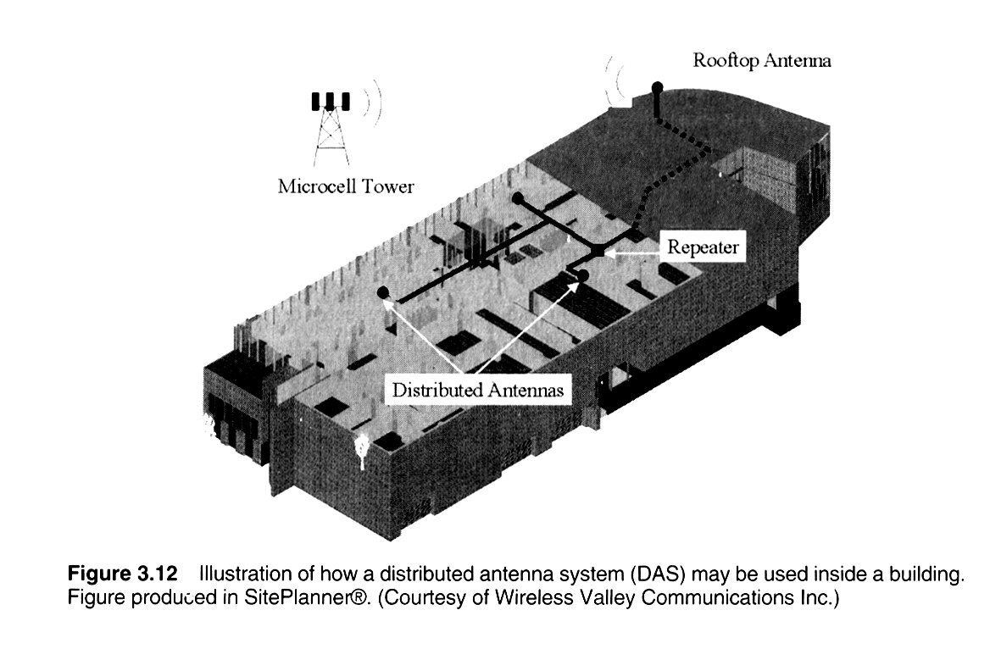
In-building deployment is the next great growth phase
Notes:
Fig. 2.14

Slide 18
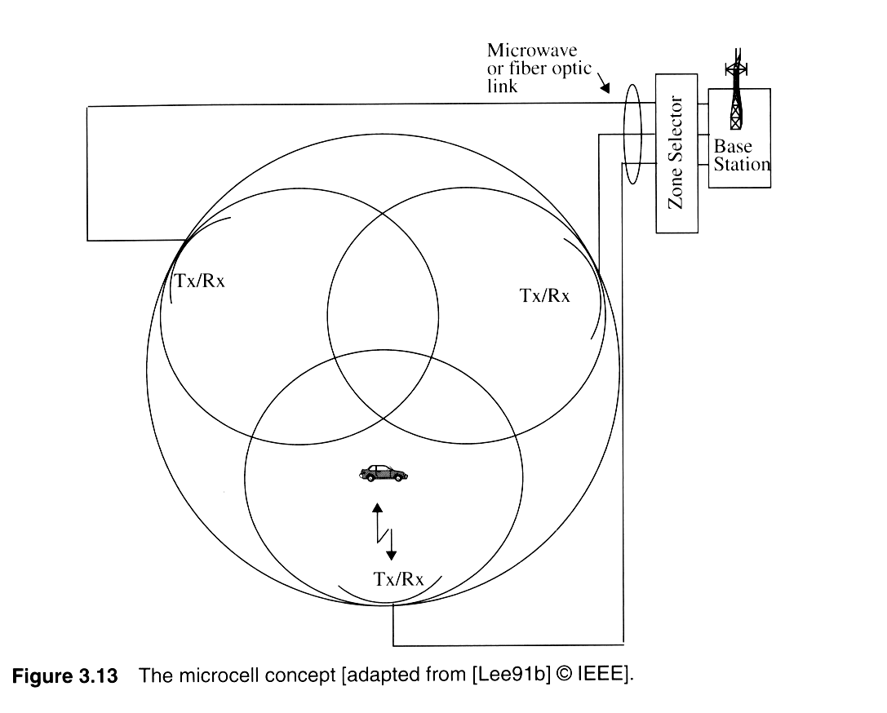
The Zone Cell Concept
Notes:
Fig. 2.15

Slide 19
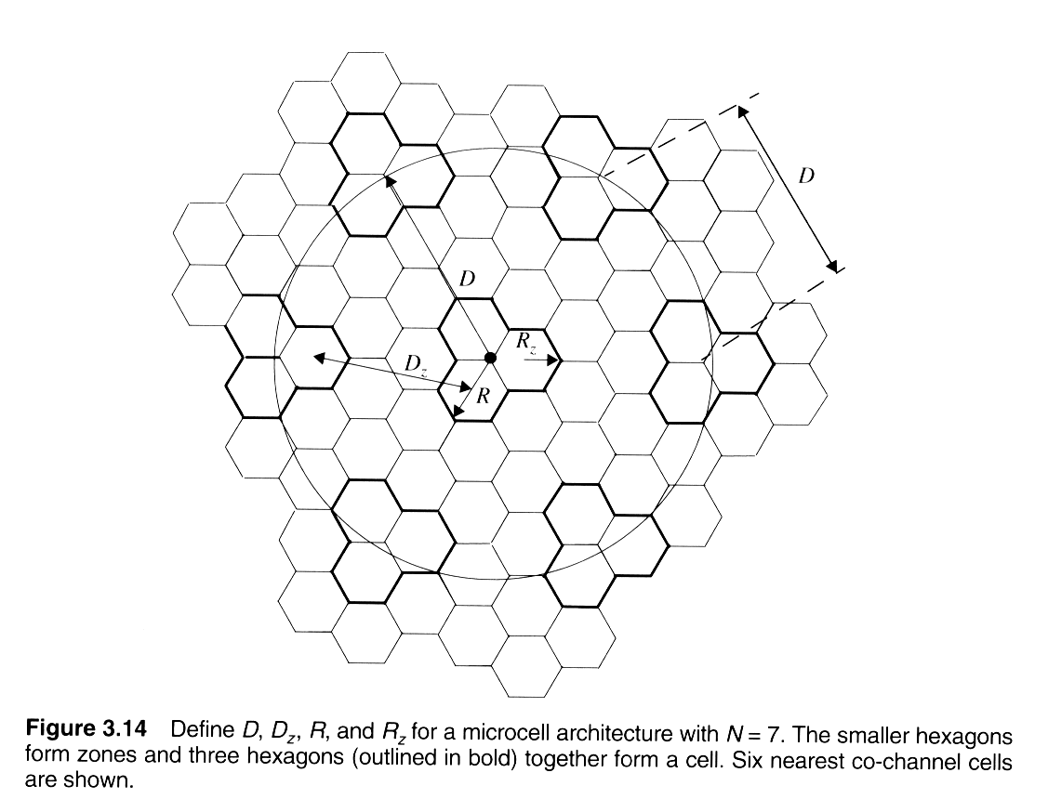
Zone Cell Concept
Notes:
Fig. 2.16

